Slide 1

TEAM UNIBOX
Project on the topic "Space Expedition"

Slide 2
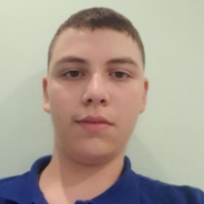
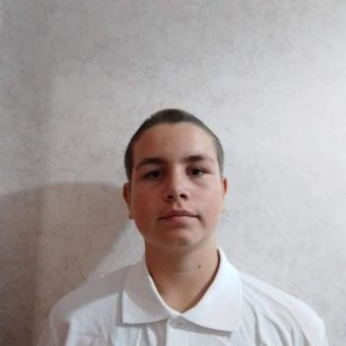
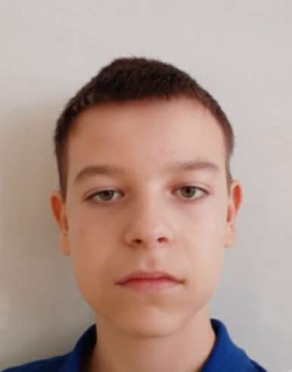
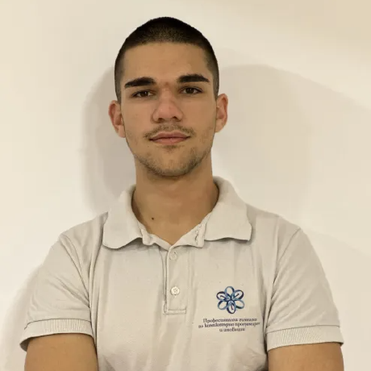
Our team
Daniel kostadinov
Ivelin voynov
Aleksandar lalev
Lychezar Rashkov
DEVELOPER
DEVELOPER
DEVELOPER
SCRUM TRAINER

Slide 3
01
03
Stages of development
02
04
Brainstorm the idea
development
Think about ideas and talk obout them.
Create the game.
Make the design
Presenting
Creating the design.
Presenting in front of judges.

Slide 4









The technologies we used

Slide 5
LET’S JUMP TO THE PROJECT!

